Slide 1
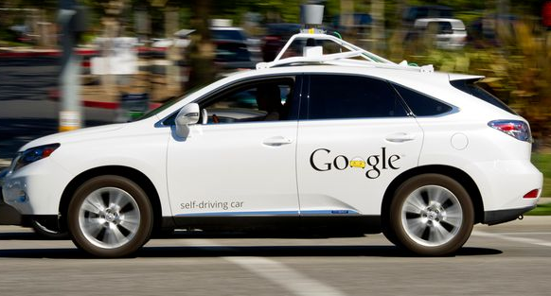
AUTONOMOUS VEHICLES M.DRUMARE

Slide 2
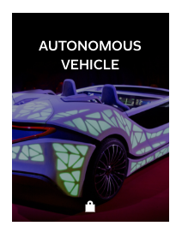
ON FLIPBOARD
http://flip.it/D5YJSd

Slide 3
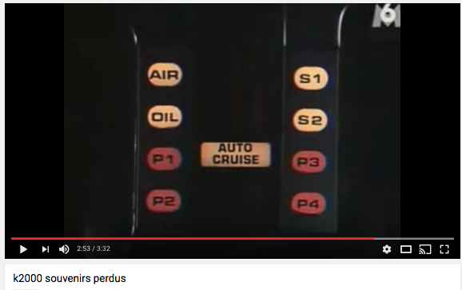
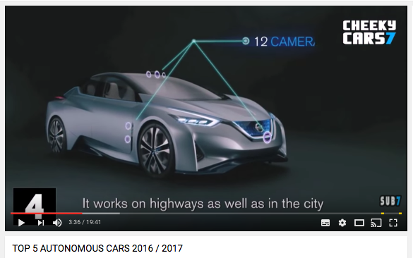

Slide 4
WHAT ?

Slide 5

2016, THE YEAR OF SELF DRIVING

Slide 6
THE NEXT FUTURE
Next generation Audi A8 capable of fully autonomous driving in 2017.
Google driverless car in the market by 2018.
Volkswagen expects first self driving cars on the market by 2019.
Delphi and MobilEye to provide off-the-shelf self-driving system by 2019.
Baidu’s Chief Scientist expects large number of self-driving cars on the road by 2019.
Nissan : provide fully autonomous vehicles by 2020.
NuTonomy: provide self-driving taxi services in Singapore by 2018, expand to 10 cities around the world by 2020.
GM: Autononomous cars could be deployed by 2020 or sooner.
First autonomous Toyota to be available in 2020.
Ford: fully autonomous vehicles for mobility services by 2021.
BMW: launch autonomous iNext in 2021.
Tesla: first fully autonomous Tesla by 2018, approved by 2021.
Jaguar and Land-Rover: provide fully autonomous cars by 2024.
Driverless cars will be in use all over the world by 2025.
Uber fleet to be driverless by 2030.
Electrical and Electronics Engineers (IEEE) predicts up to 75% of vehicles will be autonomous in 2040.

Slide 7
THE 4 TRENDS OF AUTOMOTIVE INDUSTRY
Electrification : Shift toward hybrid-electric, electric, fuel-cell technologies. As these technologies mature, they become cheaper.
Autonomous driving: Move from advanced driver assistance to fully autonomous driving as the technology matures.
Diverse mobility: As the sharing economy expands, the standard model will continue to evolve from outright purchase or lease to rentals and car sharing.
Connectivity: Possibilities for « infotainment » innovations, novel traffic services, etc.. Services will increase as cars get connected to each other, to the wider insfrastructure, and to people.

Slide 8
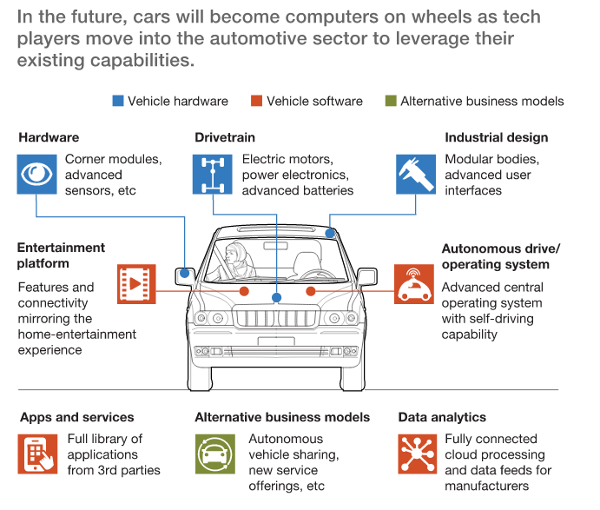
COMPUTERS ON WHEELS

Slide 9
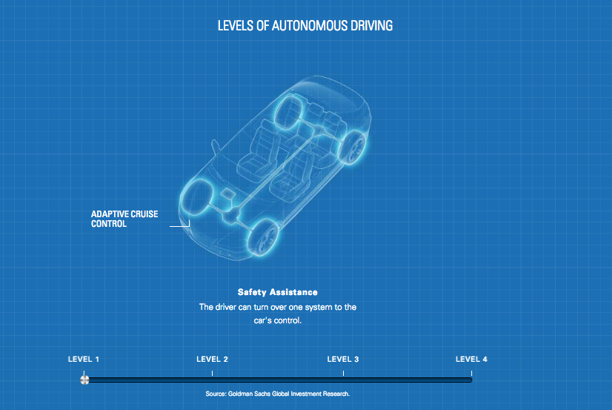
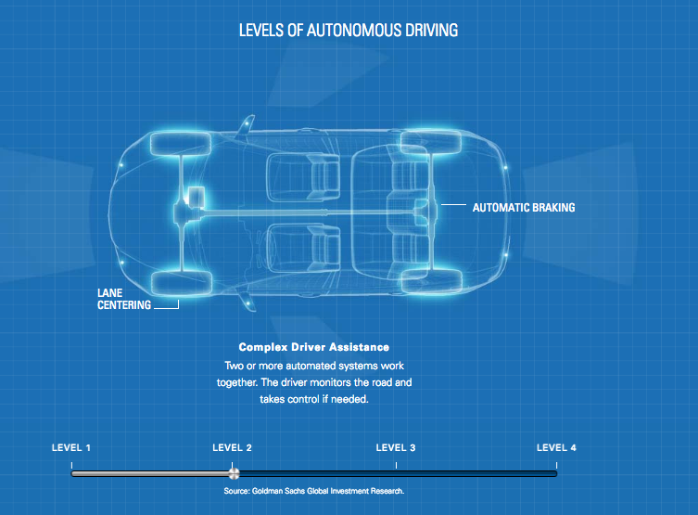
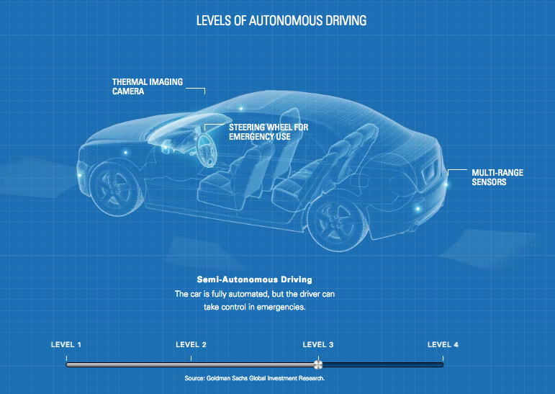
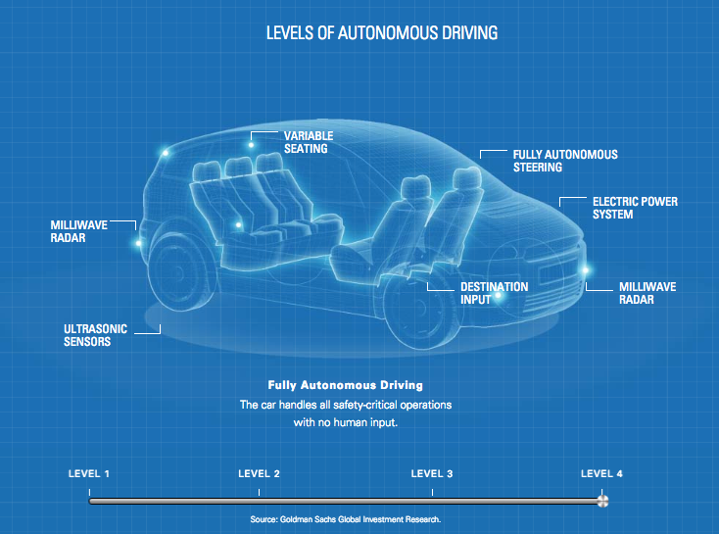
4 LEVELS OF AUTONOMY

Slide 10
LEVEL 4: AUTONOMOUS VEHICLE
Level Four Autonomy by NHTA, The National Highway Traffic Safety Administration in the United States, it means that a vehicle can operate under any condition, regardless of weather, or regardless of potential constraints in the infrastructure in the surroundings, fully autonomously, without the intervention of a driver.
It requires advanced-sensor technologies, but also multiple-sensor technologies
Regulation has to define very clearly under which infrastructure conditions one can operate such vehicles.
The acquaintance and the acceptance of autonomous solutions by the consumer.

Slide 11
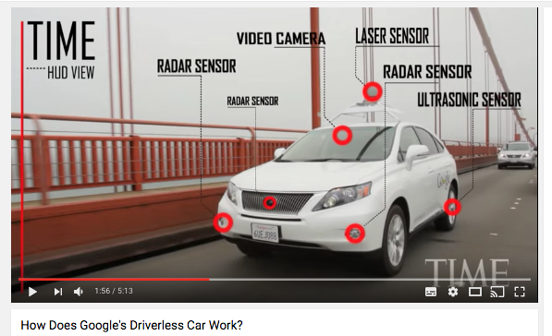
HOW DOES DRIVERLESS CAR WORK?

Slide 12
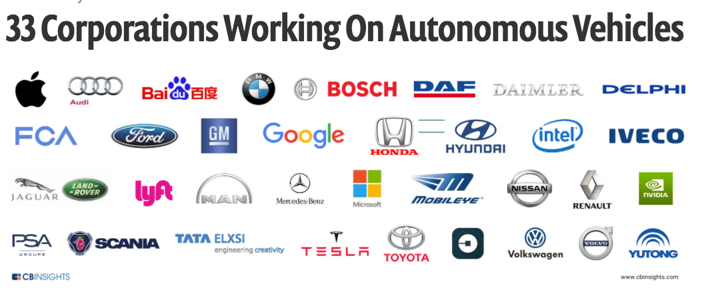
TECH GIANTS, MOBILITY PROVIDERS, CAR MANUFACTURERS, SUPPLIERS, START-UPS

Slide 13
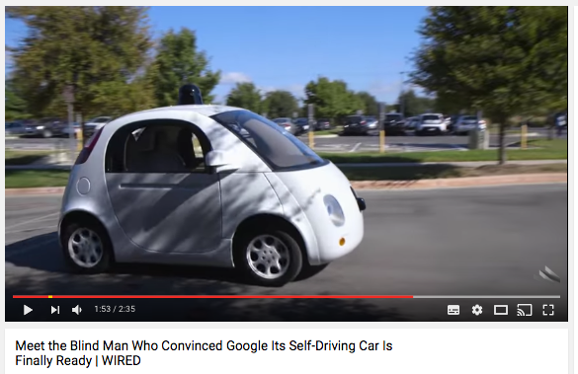
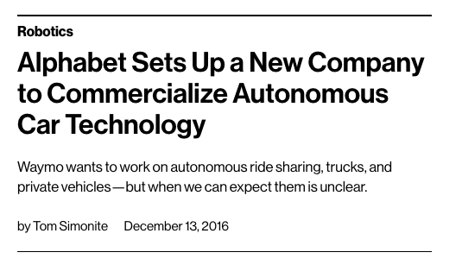
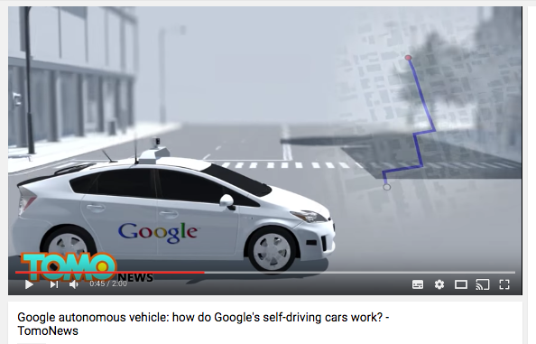

GOOGLE : THE LEADER
Google X (now X, under the Alphabet holding company) has led one of the most high-profile autonomous vehicle programs.
Google also found its first automotive partner in Fiat Chrysler Automobiles (FCA), aiming to more than double its tests fleet with 100 hybrid Pacifica minivans.
From 2009 to 2016 : https://waymo.com/journey/

Slide 14
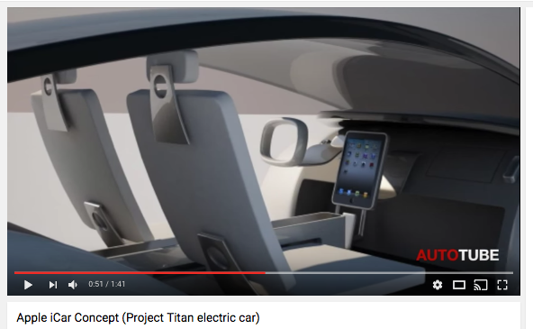
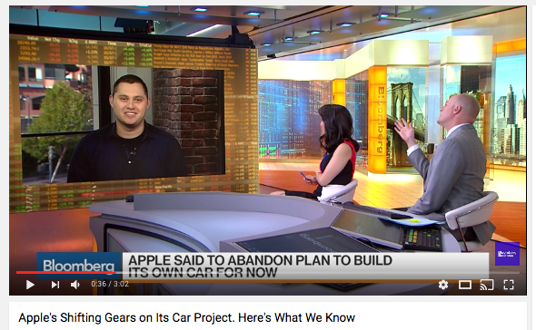
APPLE : ICAR?
Apple’s “Project Titan” is a perennial favorite within the automotive rumor mill.
Initial reports suggested the project was targeting an advanced electric vehicle, but rumors and hirings since have increasingly pointed towards self-driving development. Apple’s team is said to have grown to over 1,000 employees, poached from sources including Tesla, Carnegie Mellon, Volkswagen, and Nvidia.
End 2016, Apple has drastically scaled back its automotive ambitions, leading to hundreds of job cuts and a new direction that, for now, no longer includes building its own car, according to people familiar with the project.

Slide 15
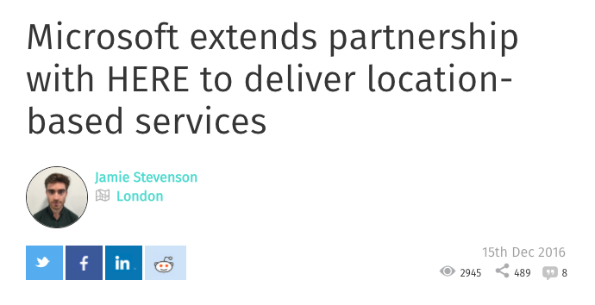
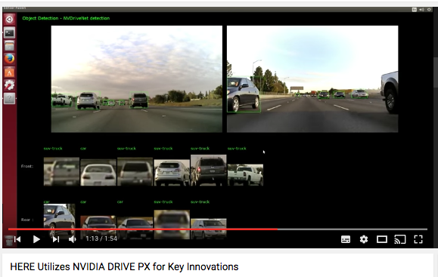
MICROSOFT: TECH ASSISTANCE ONLY
Initial strategy appears to focus on collaborations, such as a November 2015 deal with Volvo
Recently in March 2016, Microsoft and Toyota also announced the expansion of their five-year-old partnership to support Toyota’s research in robotics, AI, and self-driving car development.
Microsoft has also reportedly weighed taking a stake in the HERE high-definition mapping service, currently owned by BMW, Daimler, and Volkswagen.
HERE : https://here.com/en/innovation/here-next-generation-automotive-services

Slide 16
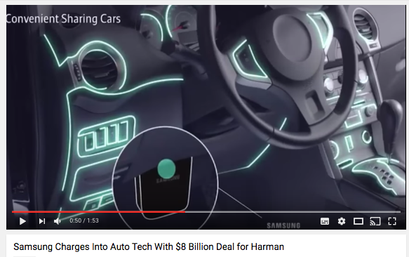
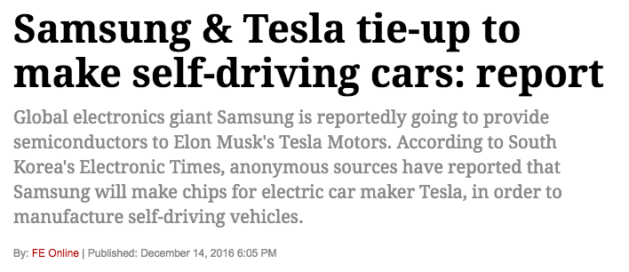
SAMSUNG : NEW ENTRANT
Samsung bought Harman International Industries for $8 billion with an aim to become a major player in the world of automotive technology.
December 2016, Global electronics giant Samsung is reportedly going to provide semiconductors to Elon Musk’s Tesla Motors.
According to South Korea’s Electronic Times, anonymous sources have reported that Samsung will make chips for electric car maker Tesla, in order to manufacture self-driving vehicles.

Slide 17
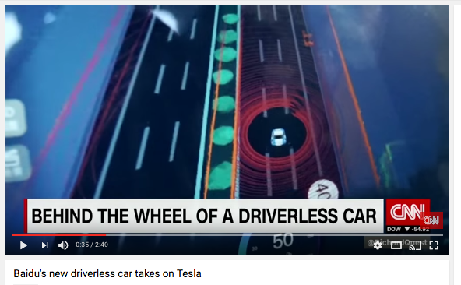
BAIDU : NEXT SELF-DRIVING OPEN PLATFORM?
In April 2014, the Chinese search giant Baidu partnered with BMW to release a semi-autonomous prototype by the end of 2015.
The partnership bore fruit in December 2015 as a modified 3-Series BMW drove an 18.6-mile route around Beijing.
August 2016, Baidu and Nvidia partnership to build an end-to-end solution for self-driving cars. It will be a “completely open” platform.

Slide 18
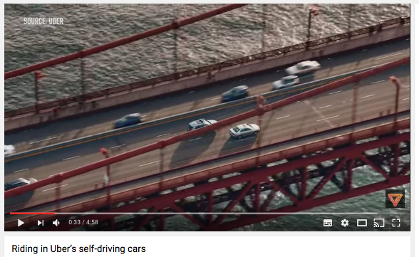
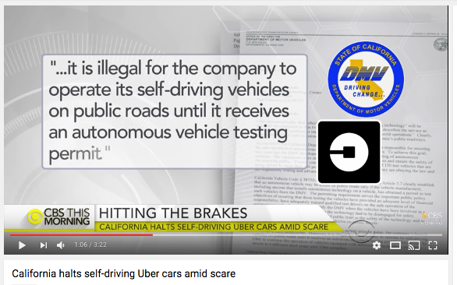
UBER : SELF-DRIVING TAXI
Uber is moving quickly, too quickly?
The company created its Advanced Technology Center, where it’s developing its driverless cars, in February 2015 by hiring a number of researchers from the robotics department at nearby Carnegie Mellon University.
Using that expertise, Uber developed its self-driving taxis in a little over a year—roughly the amount of time it takes most automakers to redesign an entertainment console.

Slide 19
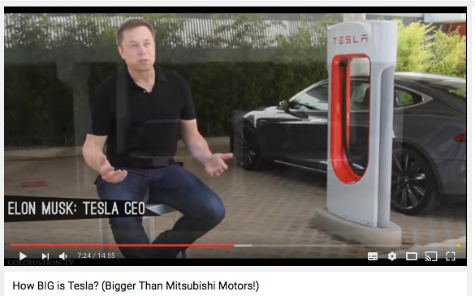
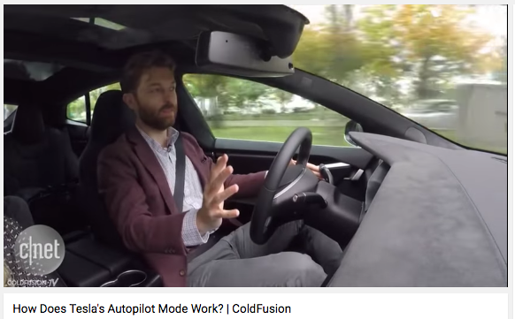
TESLA: LEADING BANNER-CARRIER
CEO Elon Musk is believing the technology behind fully autonomous vehicles is only “two to three years away,” with another “one to five years” needed for regulatory approvals.
Tesla pushed its “Autopilot” software update to properly equipped Model S vehicles in October 2016.
Telsa promises to bring semi-autonomous and autonomous features to the mass market with its much-hyped Model 3, which has already attracted over 350,000 pre-orders.

Slide 20
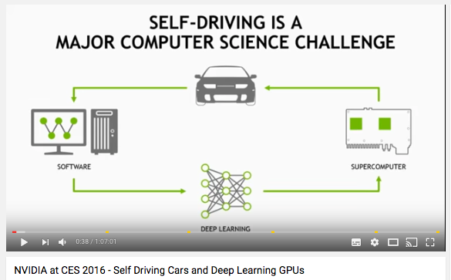
NVIDIA (DRIVE PX2) : KEY SUPPLIER
At CES in January 2016, GPU and semiconductor company Nvidia surprised many by unveiling the Nvidia Drive PX2, a powerful computing platform for autonomous cars.
Packing 8 teraflops of processing power, the platform is robust enough to support deep learning, sensor fusion, and surround vision — all key elements of a potential self-driving car.

Slide 21
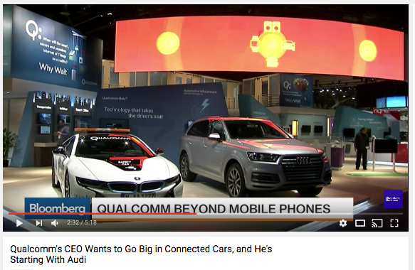
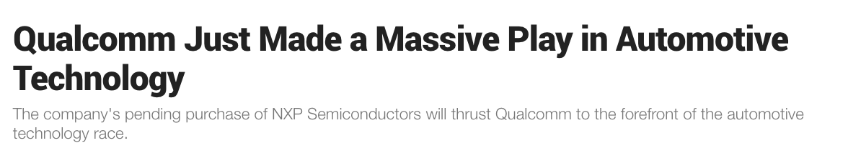
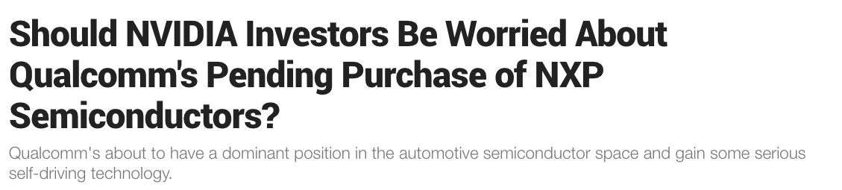
QUALCOMM: FUTURE BIG PLAYER?
November 2016, Qualcomm made a $39 billion bid to buy NXP Semiconductors N.V.
NXP manufactures its own chips and sensors and sells them to automotive companies and automotive suppliers to be used in for everything from temperature tracking to advanced driver assistance systems.
Qualcomm could have a dominant position in the automotive semiconductor space and gain some serious self-driving technology.

Slide 22
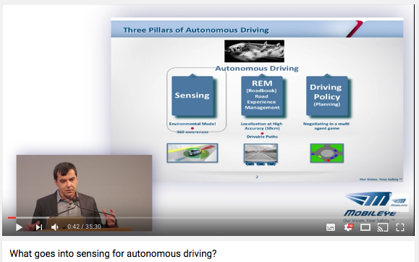
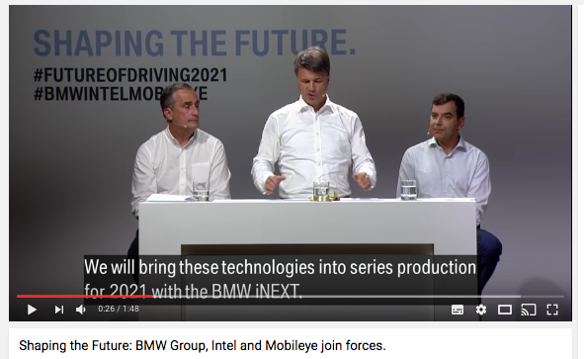
MOBILEYE (ADAS) : KEY SUPPLIER
Mobileye is an Israeli technology company that develops vision-based advanced driver assistance systems (ADAS) providing warnings for collision prevention and mitigation.
Tesla, the Mobileye system is used to power its Autopilot. Mobileye would no longer provide its computer chips and algorithms to Tesla after a current contract ends due to disagreements about how the technology was deployed.
Agreements to supply camera-based driver-assistance systems to more than a dozen auto makers, but its relationship with Tesla helped bring it to the attention of auto analysts and Wall Street.
The supplier announced a partnership with BMW and Intel Corp. to design a system for fully autonomous vehicles by 2021.

Slide 23
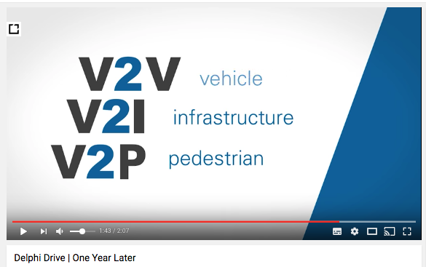
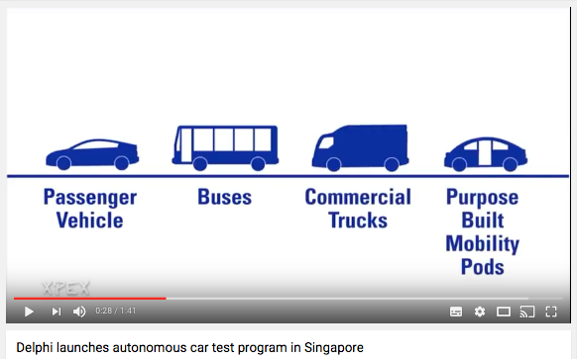
DELPHI AUTOMOTIVE (V2E) : KEY SUPPLIER
Vehicle to Everything: Delphi, a large automotive parts supplier headquartered in the UK, has created a network of software and sensors that can be outfitted into existing car models to make them autonomous.
April 2016, an Audi SQ5 outfitted with Delphi technology drove itself 3,000 miles across the US, doing 99% of the driving by itself.
Delphi was also recently selected by the Singapore’s Land Transity Authority to begin an automated mobility pilot program in the city-state.

Slide 24
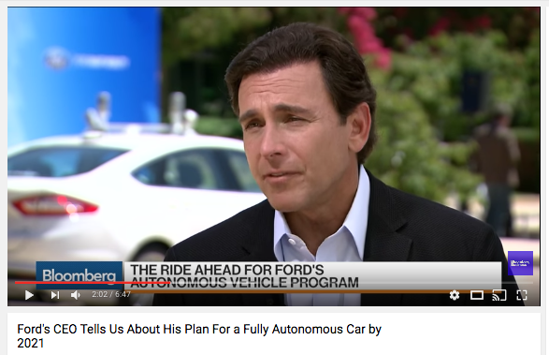
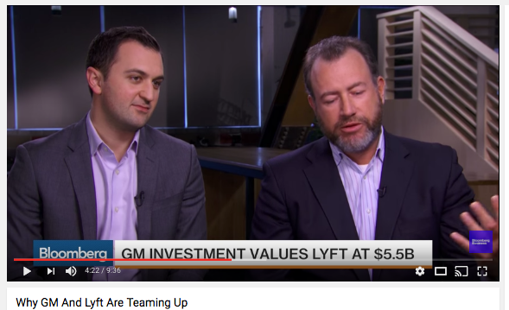
AMERICAN MANUFACTURERS
Ford: Formation of Ford Smart Mobility LLC in March 2016, a new subsidiary focused on connectivity, autonomous vehicles, and mobility (e.g. car- and ride-sharing services). As part of its 10-year autonomous vehicle plan. November 2016, BlackBerry announced a partnership with Ford to develop software for automobiles.
GM: In January 2016, the company invested $500M into Lyft (Uber competitor). March 2016, saw GM’s acquisition of autonomous tech startup Cruise Automation. GM has also detailed plans to hire 700 engineers focused on autonomous R&D.

Slide 25
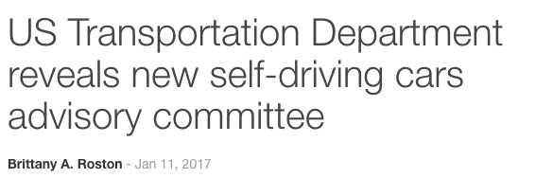
AMERICAN SELF—DRIVING COMITTEE
This committee aims to address issues related to both developing and deploying automated vehicles, as well as other issues ‘facing transportation today.’
More than two dozen committee members have already been named, including co-Chair Mary Barra of General Motors and co-Chair Eric Garcetti, the mayor of Los Angeles. The advisory committee’s Vice Chair position is held by Stanford University engineering professor Dr. J. Chris Gerdes.
The advisory committee’s board members include individuals from Zipcar, FedEx, Hyperloop One, Delphi Automotive, the National Safety Council, Apple, the American Trucking Association, State Farm Insurance, Lyft, the Transportation Trades Department, the University of California at Berkeley, Uber, Duke University, and more

Slide 26
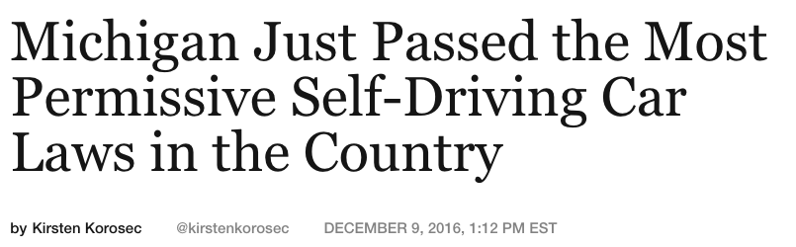
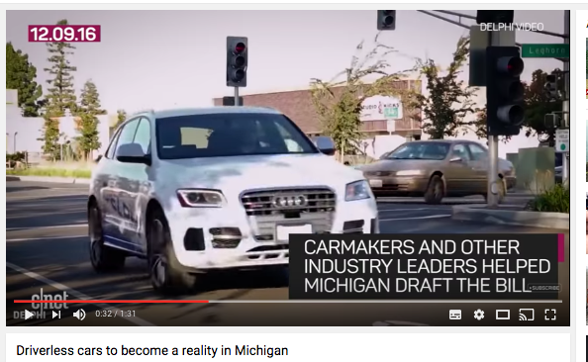
NEW MICHIGAN’s SELF-DRIVING CAR LAWS
December 2016. New Michigan’s regulations for the testing, use, and eventual sale of autonomous vehicle technology and are meant to more clearly define how self-driving vehicles can be legally used on public roadways.
The new laws allow testing of vehicles without steering wheels, pedals, or needed human control—an important allowance that aims to propel Michigan ahead of California, a hotbed of driverless car development.

Slide 27
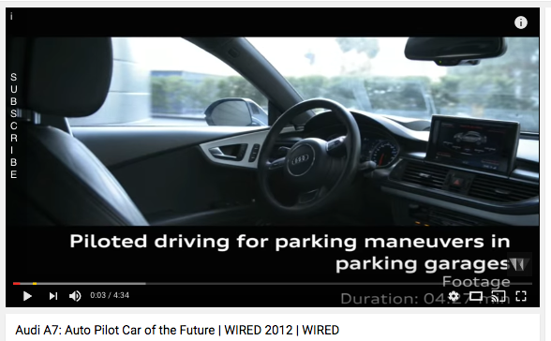
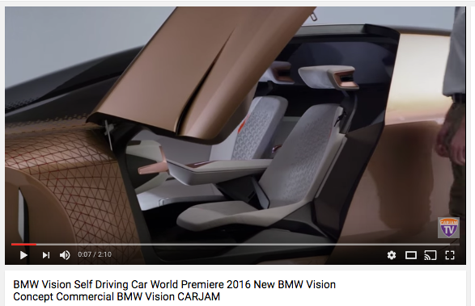
GERMAN MANUFACTURERS
Audi has revealed a number of autonomous vehicle prototypes derived from their A7- and RS7 models. Audi aims to commercialize their “Audi Piloted Driving” in their next A8. Audi is part of the German consortium — including Daimler and BMW — that bought Nokia’s HERE precision mapping assets for $3.1B.
BMW announced an alliance with chipmaker Intel and supplier Mobileye. The coalition plans to create an open standards-based platform for bringing self-driving cars to market, aiming to put vehicles on the road by 2021.

Slide 28
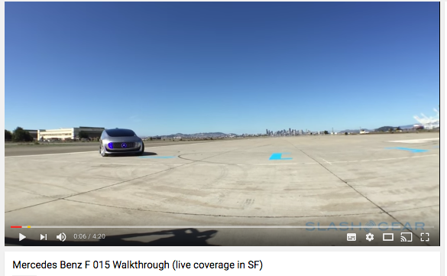
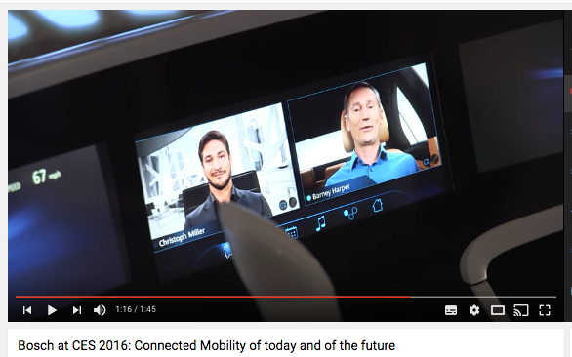
GERMAN MANUFACTURERS
Mercedes unveiled in January 2016 their concept F 015 autonomous vehicle, which the company said would be ready in 15 years.
Bosch, one of the world’s largest automotive suppliers, has responded to an increase in demand by dedicating more than 2,000 engineers to driver-assistance systems.
Bosch counts Google, Tesla, and Porsche as clients.

Slide 29
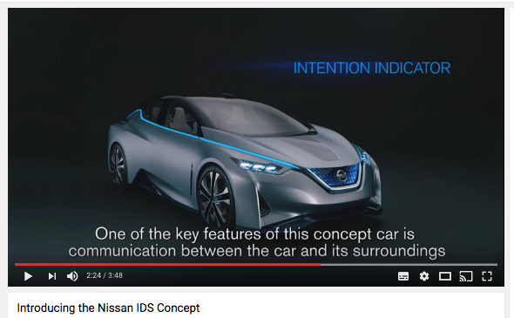
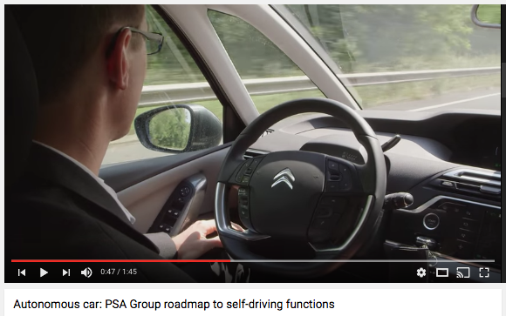
FRENCH MANUFACTURERS
Renault/ Nissan : Chairman and CEO of Nissan and Renault Carlos Ghosn promised that the group would have 10 vehicles on sale by 2020 with “significant autonomous functionality.”
Nissan and Toyota also announced a joint effort to develop standardized “intelligent” maps.
Groupe PSA : April 2016, PSA Groupe announced that two Citroën cars had driven “eyes off” from Paris to Amsterdam. The vehicles navigated over 300 km.

Slide 30
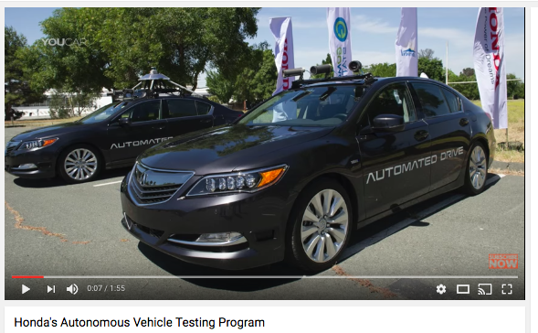
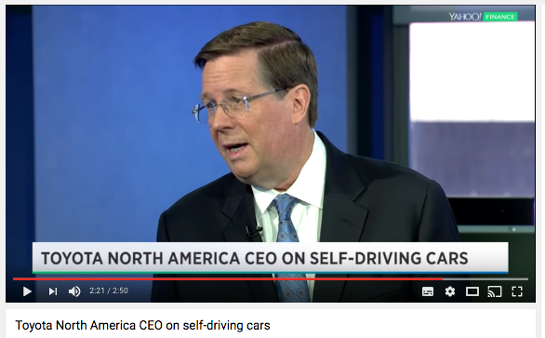
JAPAN MANUFACTURERS
Honda introduced semi-autonomous ADAS (advanced-driver assistance systems) options on its entry-level Civic, offering lane-keeping, automatic braking, and adaptive cruise control functionality. Honda received approval from California to test autonomous vehicles on public streets.
Toyota announced a $1B budget for autonomous driving research, establishing its advanced Toyota Research Institute.
Toyota hired professors and researchers from Stanford University, MIT, and the entire staff of the autonomous vehicle company Jaybridge Robotics.
May 2016, Toyota’s deal with Uber will bolster Uber’s moves into a self-driving vehicle future.
Toyota has targeted 2021 as a goal for deploying “AI car features” to the road.

Slide 31
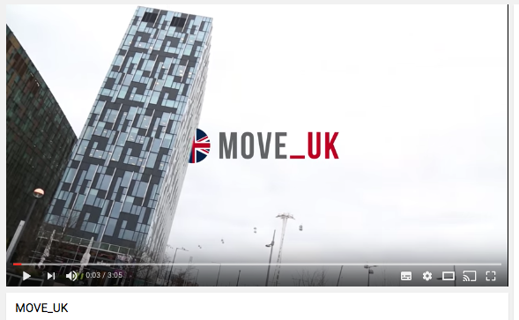
INDIAN MANUFACTURER TATA
Tata Elixsi, a division of the TATA group, showcased technology in January 2015 for an autonomous parking valet, in which the car understands where open spots are and uses sensors to park itself.
In Feburary 2016, Tata owned company, Jaguar Land Rover joined a $7.9M UK program « Move-UK » to further autonomous driving R&D, aiming to gather data on driving habits and test vehicle communications technology.

Slide 32
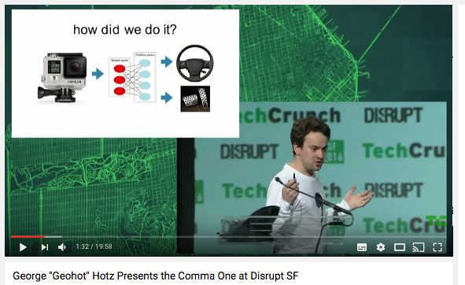

SELF-DRIVING START-UP: COMMA.AI
George Hotz launched his self-driving car startup, Comma.ai, a year ago out of his garage at the “Crypto Castle” in San Francisco’s Potrero Hill neighborhood.
In September 2016, he announced the shipping of a self-driving Car Kit ($999 for the hardware and another $24 a month for a subscription to the software)
The kit only work on certain Honda and Acura cars with lane-keeping assistance features. Comma One will take advantage of the radars and cameras built into those vehicles.
December 2016, pressure from the government has forced Comma.ai to cancel its self-driving kit and to open source an advanced driver assistance system. (https://commaai.blogspot.fr/)

Slide 33
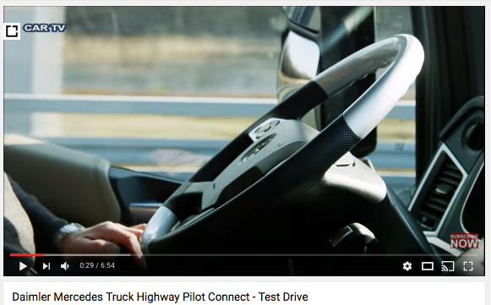
AUTONOMOUS TRUCK: PLATOONING CONCEPT
Spring 2016, DAF, Daimler, Iveco, MAN, Scania, and Volvo Complete Truck ‘Platooning’ Trip.
A dozen trucks from a diverse group of European trucking brands, originating from various factories in Sweden and Germany, and converging in Rotterdam.
Within the semi-autonomous “platooning” concept, multiple trucks controlled by a lead truck are connected through wireless signals, forming a train with one truck following behind another.
the Volkswagen Group owns a controlling stake in both MAN and Scania. Daimler Trucks is a division of Daimler AG.

Slide 34
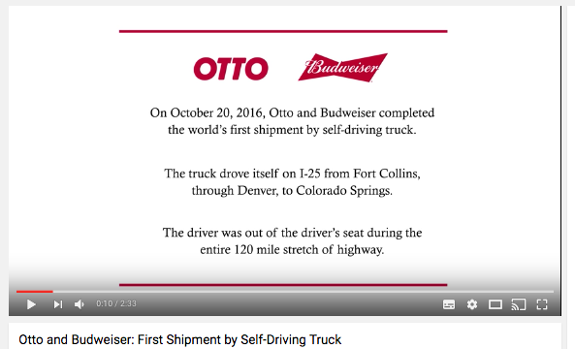
AUTONOMOUS TRUCK : OTTO
October 2016, Uber's newly acquired division, Otto, partnered with Anheuser-Busch to deliver beer in a self-driving tractor-trailer.
Otto is a San Francisco based startup that makes software and hardware kits for self-driving vehicles.
The company was acquired by Uber in August and is being re-branded as Uber Freight.Its kit adds Cameras, LIDAR, GPS, RADAR, and other sensors to semi-trucks to turn them into level-4 autonomous vehicles.

Slide 35

ELECTRIC AUTONOMOUS BUS : OLLI
The electric shuttle from Local Motors named "Olli" is on trial in the Washington area.
The company is planning a commercial launch in 2017 in several cities including Las Vegas and Miami.
Olli can carry 12 passengers, partly 3D printed vehicle, first to integrate IBM's "Watson" cognitive computing technology, allowing passengers to interact with it and ask questions, such as what route the bus is taking and what attractions their destination offers.
Olli makes use of lidar, a laser-sensing system also employed by Google's driverless cars, to read the road.
The use of 3-D printed material enables rapid mass production. The first Olli was created in just two weeks, and new micro-factories are to be launched across USA.

Slide 36

AUTONOMOUS BUS : THE FUTURE BUS
July 2016, The Mercedes-Benz's semi-autonomous bus, called the Future Bus, drove a little more than 12 miles from Amsterdam's Schiphol airport to Haarlem, a city just outside Amsterdam.
The bus's journey was especially impressive because the route included traffic lights, tunnels, and required the bus to navigate around people.

Slide 37

AUTONOMOUS BUS :WEpods
The WEpods gradually learned the route on the Wageningen Campus and to Ede-Wageningen train station.
Engineers mapped the route in great detail, allowing the WEpods to follow a straight, fixed line through the streets they were navigating.
The Team also developed a smart sensor system with lasers, radars and cameras which allows the WEpod to anticipate other traffic more effectively and distinguish a person from other objects such as a branch, for example.
This includes self-learning software to ensure that the WEpods become smarter as time goes by.

Slide 38


AUTONOMOUS SHUTTLE IN LAS VEGAS
The shuttles are the result of a partnership between shuttle-maker Navya, fleet logistics provider Keolis and the city of Las Vegas.
January 2017: Riding a regular route along iconic Fremont Street between Las Vegas Boulevard and Eighth Street — right in the thick of regular traffic.
The Arma figures out where it is thanks to Lidar, cameras, and odometry. The first time the vehicle drives a route, it needs to be driven manually by an engineer using a joystick. Once the route is set, then the joystick is removed and the car doesn't have a steering wheel back up. Everything happens through the AI.

Slide 39


SECURITY ISSUES
Google has logged over two million miles of on-the-road driving with its fleet of 60 autonomous vehicles.
Its monthly transparency data on accident reports shows only 17 minor accidents over seven years, none involving serious injury.
In most of these situations, the accidents were caused by humans in other vehicles acting in unpre-dictable ways or rear-ending the autonomous vehicle.
But…On May 8, Joshua Brown was driving on a divided highway in Florida using autopilot when a tractor-trailer drove across the highway perpendicular to the Model S. Brown died.
The National Hightway Traffic Safety Administration investigated the crash.

Slide 40
OBSTACLES TO ADOPTION AND UTILIZATION
Bad weather represents an area where driverless cars do not perform very well.
Security is an important consideration in this sector. There have been reports of vehicles hacked and systems disrupted.
Poor highways pose challenges for autonomous vehicles. Cars need predictable surfaces and clearly defined traffic lanes
Inadequate spectrum is a major barrier in many countries. Finding dedicated frequency ranges is key to supporting autonomous vehicle. Autonomous vehicles and industrial applications need mid-range spectrum below 6 GHz.
Public acceptance : 46 percent of Americans said they prefer no self-driving vehicles, followed by 39 percent who like partial self-driving [semi-autonomous] and 16 percent who support complete self-driving [fully autonomous] cars.

Slide 41


AUTONOMOUS VEHICLE LEGISLATION
Nevada was the first state to authorize the operation of autonomous vehicles in 2011.
Since then, seven other states—California, Florida, Louisiana, Michigan, North Dakota, Tennessee and Utah—and Washington D.C. have passed legislation related to autonomous vehicles.
Ontario in Canada gave the green light for autonomous vehicles in October 2015.
On 19 February 2016, Assembly Bill No. 2866 was introduced in California that would allow completely autonomous vehicles to operate on the road, including those without a driver, steering wheel, accelerator pedal, or brake pedal.
In December 2016, the California Department of Motor Vehicles ordered Uber to remove its self driving vehicles from the road in response to two red-light violations.

Slide 42


AUTONOMOUS VEHICLE LEGISLATION
In 2013, the UK government permitted the testing of autonomous cars on public roads
Spring of 2015, the Federal Department of Environment, Transport, Energy and Communications in Switzerland (UVEK) allowed Swisscom to test a driverless Volkswagen Passat on the streets of Zurich.
Spring 2016, The German government adopted a bill on traffic rules to accommodate automated driving.
Summer 2016, the French government gave the go-ahead for driverless cars to hit the highway on a trial basis, as part of the government's "New industrial France" plan to make some 34 areas of the economy more competitive on the world stage.
August 2016, U.S. startup NuTonomy has launched a trial in Singapore of what it says is the first driverless taxi fleet in the world. Delphi announced tests in 2017.

Slide 43

POTENTIAL GROWTH
Between now and 2021, The World Economic Forum estimates that the digital transformation of the automotive industry will generate $67 billion in value for that sector and $3.1 trillion in societal benefits.
That includes improvements from autonomous vehicles, connected travelers, and the transportation enterprise ecosystem as a whole.
For Nvidia CEO, AI Transportation market is a $10 Trillion Industry-September 2016.

Slide 44


POTENTIAL GROWTH: CHINA AMBITION
Two driverless cars developed by China's Chang'an Automobile Group ended a long-distance (1200 miles) test drive from Chongqing to Beijing, April 2016.
China aims to be n°1 in automous car by 2030 (“The Technology Road Map For Energy Saving and New Energy Vehicles. December 2016)
“Partially-autonomous” cars (think driver assist) are to account for 50 percent of sales by 2020.
By 2030, fully autonomous vehicles are expected to feature in 10 percent of sales. That’s 4 million completely robocars annually.

Slide 45
HOW ?

Slide 46

DARPA CHALLENGES
The U.S. Department of Defense’s research arm, DARPA, sponsored a series of challenges that pushed autonomous technologies forward.
In 2004, a competition was held to challenge vehicles to self-navigate 150 miles of desert roadway. While no car completed the route, subsequent challenges have seen dramatic leaps in capabilities.
The 2007 challenge simulated a 60-mile long urban environment, with four cars completing the route in the allotted six-hour time limit.

Slide 47

CREATE AN AUTONOMOUS CAR ECO-SYSTEM
The University of Michigan’s 32-acre Mobility Transformation Center, called Mcity was launched in 2015 as a world-class test facility for autonomous vehicle technology.
Ford became the first automaker to test autonomous vehicles there
Making autonomous vehicles a reality “cannot be done by any single organization. It will require a public-private partnership, and a community of legislators and researchers and technology companies and automobile manufacturers.”

Slide 48

DEVELOP AN ADVANCED DRIVER ASSISTANCE SYSTEM
Demand for advanced driver-assistance systems (ADAS)—those that help with monitoring, warning, braking, and steering tasks—is expected to increase over the next decade, fueled largely by regulatory and consumer interest in safety applications that protect drivers and reduce accidents.
The same technologies that enable today’s ADAS offerings could also be used to create fully autonomous vehicles, which are now a major focus of research and development.

Slide 49

ADAS AND AUTONOMOUS DRIVING
Processors. Electronic control units (ECUs) and microcontroller units (MCUs) are essential for most ADAS applications, including autonomous driving.
Sensors (Sense). These devices gather information on their immediate environment, such as pedestrians and oncoming cars.
Mapping (Map). When GPS coverage fails, such as during tunnel travel, detailed and accurate mapping systems can help prevent accidents. These systems also store geographical and infrastructure information, making updates as needed, and communicate with onboard sensors to determine a car’s exact location.
Software algorithms (Act).
Running on ECUs and MCUs, algorithms use the input from sensors to synthesize the environment surrounding a vehicle in real time.
The algorithms then provide output to the driver or specify how the system should actively intervene in vehicle control.

Slide 50




SENSE, PLAN, ACT
MAP
SENSE
ACT

Slide 51


ENHANCE ACT

Slide 52


INVEST IN AN OPEN AI PLATFORM
The open platform NVIDIA DRIVE uses AI to advance the driving experience, from infotainment to autonomous vehicles.
The data gathered from sensor-filled cars will be used to create comprehensive HD maps.
Nvidia AI Self-driving cars in development : Baidu, nuTonomy, Volvo, Wepods.
http://www.nvidia.fr/object/drive-px-fr.html

Slide 53

MAKE A PARTNERSHIP WITH ADAS KEY PLAYERS
Established high-tech companies, including semiconductor players, are actively pursuing ADAS opportunities, even if they did not previously have a presence in the automotive sector.
Intel, NVIDIA, Panasonic, Qualcomm, Samsung, and Sony are going after such opportunities.
Start-ups and other small to mid-size companies in the high-tech and automotive sectors are now trying to capture market share : GestureTek, Hawk-Eye Innovations, and IntelliVision, all of which have specialized expertise in image processing and computer vision.

Slide 54


INVEST IN DEEP LEARNING
Drive.ai's approach is using deep learning across the board in its autonomous driving system.
Providing a host of examples of situations, objects and scenarios and then letting the system extrapolate how the rules it learns there might apply to novel or unexpected experiences.
It still means logging a huge number of driving hours to provide the system with basic information.
https://www.drive.ai/

Slide 55

nuTonomy MODEL

Slide 56
IMPACTS ?

Slide 57


AV IS A JOB KILLER
Driving jobs :
Taxi drivers.
Uber & Lyft drivers.
Delivery (FedEx, UPS, USPS) jobs.
Courier jobs.
Bus drivers.
Truck drivers.
Valet jobs.
Chauffeurs and limo drivers.
Transportation industry’s jobs :
Drivers teachers.
Driving schools.
Traffic analysts.
Car licensing and registration.
Drivers test people.
Rental car agents.
Crash testers.
Human Operators:
Forklift drivers.
Lawnmower operators.
Snowplow operators.
Water truck drivers.
Fire truck drivers.
Ambulance drivers.
Trash truck drivers.

Slide 58


AV IS A JOB CREATOR
Communication Specialists.
IT Technicians.
Electrical Engineers.
Mechatronics.
Data Analysts.
Automated Driving Engineers.
Modelling and simulation specialists.
Researchers.
Software Programmers.
Mechanics.
More details : https://goo.gl/oPpQRY

Slide 59

CITIES, STATES, COUNTRIES COMPETITION
December 2016, Arizona governor Doug Ducey welcomed Uber's self-driving pilot one day after the California Department of Motor Vehicles moved to revoke the vehicles' registrations.
“Arizona welcomes Uber self-driving cars with open arms and wide open roads," Ducey said in a statement. "While California puts the brakes on innovation and change with more bureaucracy and more regulation, Arizona is paving the way for new technology and new businesses."

Slide 60


IMPACT ON PUBLIC TRANSPORT
The first fully autonomous vehicles to appear on roads will probably be robot taxis or self-driving buses.
Many current projects focus on such autonomous mobility services.
WEPods (Netherlands).
CityMobil2 (Greece and EU).
Milton Keynes driveless pods, Ultrapods (United Kingdom).
Bestmile (Switzerland).
EasyMile, Google self-driving pods (USA, California).
One-North , Sentosa (Singapore).
RobotTaxi (Japan).
Baidu , Yutong Bus (China).

Slide 61




IMPACT ON RIDE-SHARING
Ride-sharing companies as Uber, Lyft, nuTonomy, Didi Chuxing are investing in autonomous vehicles.
They see advantages in terms of customer service and labor productivity. All of the major ride-sharing companies are exploring driverless cars.

Slide 62


IMPACT ON SUPPLY CHAIN
In the USA Trucks comprise 5.6 percent of vehicular miles in the United States, but 9.5 percent of the fatalities. Autonomous vehicles could add considerable value, both in terms of money and lives saved.
Large trucks often cost over $150,000. The introduction of cameras and sensors are quite cost effective compared to the case with automobiles, where the additional expense is based on a lower overall cost.
In the United States, the firm Ottomotto is testing fully autonomous 18-wheel trucks.

Slide 63


IMPACT ON AGRICULTURE & CONSTRUCTION

Slide 64

IMPACT ON INSURANCE
If an accident is the result of a computer’s failure, it becomes reasonable to assume the fault would then lie with the manufacturer not the driver.
If the car manufacturers are facing increased operating costs due to liability concerns, they may make up for that by increasing the price of the vehicles.
While autonomous vehicle owners may save money on their insurance policies, the cost may end up trickling down to the price of their new ride.
Safer road conditions may also lead to a decreased demand for auto insurance

Slide 65
SAFETY, TRAFFIC CONGESTION, AIR POLLUTION
According to the World Health Organization: 1.24 million people die annually due to highway accidents. Traffic fatalities cost $260 billion each year and accident injuries : $365 billion. McKinsey prediction is that a society of self-driving cars could see a reduction in crash rates up to 90%.
In the United States, drivers spend an average of 40 hours stuck in traffic, at an annual cost of $121 billion. For Moscow, Istanbul, Mexico City, or Rio de Janeiro: drivers can spend “more than 100 hours a year in congested traffic.
Automobiles are major contributors to poor quality air. According to a RAND study, Autonomous vehicle’s technology can improve fuel economy, improving it by 4-10 percent by accelerating and decelerating more smoothly than a human driver.

Slide 66


BENEFITS FOR SENIOR CITIZENS AND THE DISABLED
Each face mobility restrictions based on physical limitations and/or visual acuity, and therefore see a number of benefits from intelligent cars.
Self-driving vehicles give them mobility without dependence on friends and relatives.

